Slide 1
DRESS: Distributed Remote Environment Sensor Suite
Kevin Rak and Eric Eilberg

Slide 2
Introduction
DRESS is a highly scalable method of monitoring temperature and humidity from multiple locations
Many uses
Keep track of environmental data around the home (better than a thermometer hanging outside your window)
Store data for integration with a smarthome HVAC system
Monitor a temperature or humidity specific application
Humidor, wine cellar, greenhouse, etc

Slide 3
Components
Hardware Components:
Utilizes low cost Raspberry Pi and DHT11 sensors
Requires network connectivity
Software Components:
Remote Sensor Modules (RSMs) are PIs with the DHT11s, and a software package to record data from DHT and send to database
Graphical User Interface (GUI) presents data from the database to the user. Can show temperature, humidity, time, and data source.

Slide 4
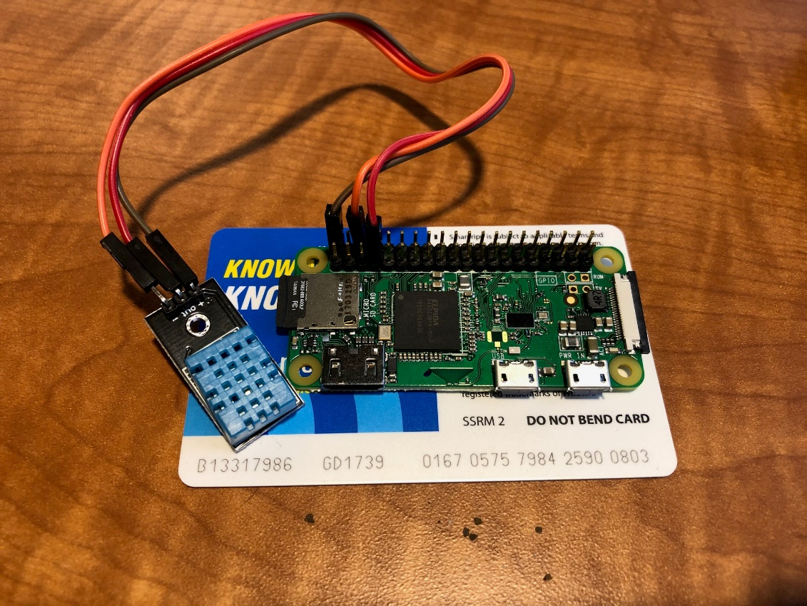
Hardware Deep Dive
Raspberry Pi
Pi Zeros as RSMs
Low cost no frills boards
Small form factor
Pi 3b as GUI host
Low cost with a few more features
DHT11 sensors
Cheap and readily available
Pi Zero with DHT11 attached. Shown resting on a credit card sized Washington, DC metropass for size comparison.

Slide 5
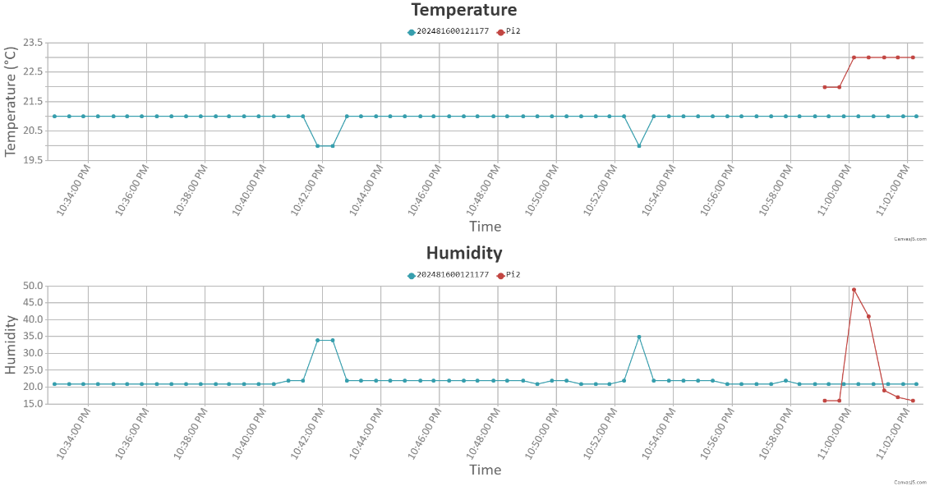
Software Deep Dive
GUI Program
Written in C
Encapsulated to reduce affects of dependency changes
RSM Program
Written in python
Hardware library requirements must be matched between sensor and board, so not as much encapsulation available
Screen Capture of GUI

Slide 6
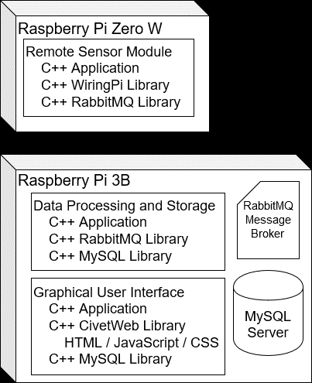
Process Deep Dive
Build using CMAKE
Consistent build methodology
Pulls in all encapsulated components
Commented with Doxygen style
Automatically generates documentation by pulling comment info from the code
Continuous Integration with Travis CI
Ensures code quality by building automatically and reporting errors
Compliance analysis with OCLint
Framework for future automated testing and regression
DRESS Technical Stack

Slide 7
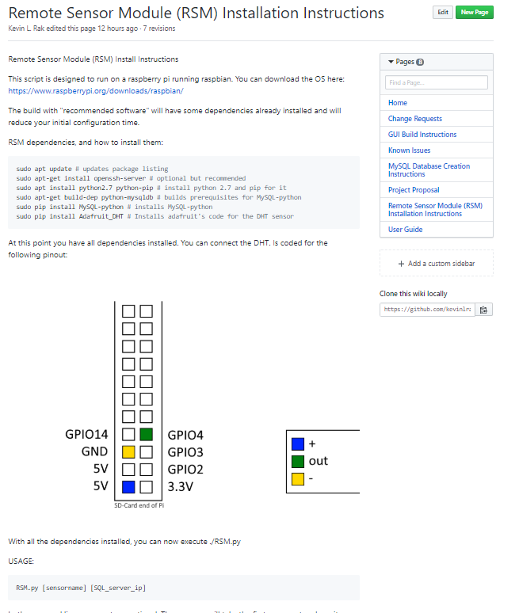
Project Location - https://github.com/kevinlrak/csu-eec521
GITHUB
All source code
Design Documents
Tech Stack Drawings
User Stories
Project Planning
Code Documentation
Doxygen generated docs
Wiki with user guide, instructions, code snippets, and pinout drawings
Known Issues listed on project website
Error reporting via Github issues
Documentation on GitHub Wikipedia

Slide 8
Questions?
On to the live demo!

